Slide 1
Company
& Technology Presentation

Slide 2
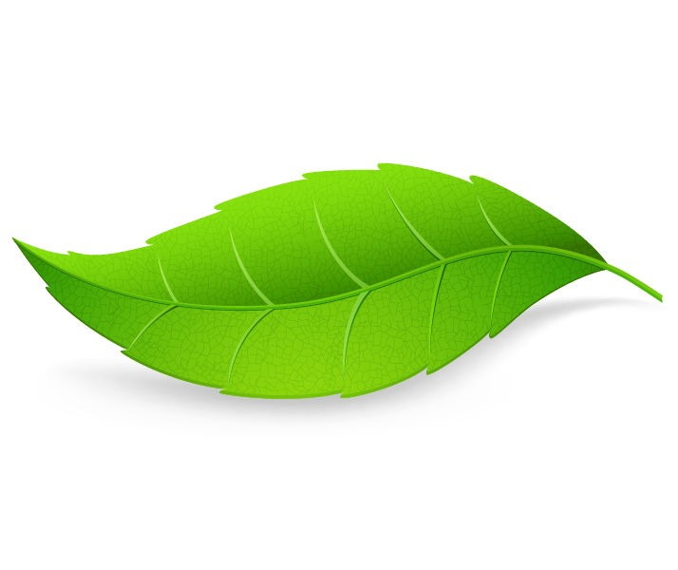
Company / IIYH
Jan Gustavsen – CEO of IIYH Norway
IIYH AS represents the Ydro Process® product range in Norway, Denmark and Spain.
Offices in Oslo/Norway and Benidorm/Spain.
Serving customers within Wastewater treatment and Bio Gas production.
Working closely with Hydrotech (Producer of Ydro) to serve our customer in a best possible way.
MISSION:
HELPING THE GREEN TRANSFORMATION WITH NATURAL BIOLOGICAL SOLUTIONS

Slide 3
We achieve goals that cannot be met by conventional methods.
Reduction of sludge for disposal
Natural reduction of Phosphorous to a level <1 mg/l
Reduction of CO2 emissions
Reduction in energy usage
Reduction of operational mechanical cost
Giving environmental benefits by producing better effluent values
HELPING THE GREEN TRANSFORMATION WITH NATURAL BIOLOGICAL SOLUTIONS

Slide 4
Latest project
Customer: Norways largest treatment plant for wastewater from Equinor’s oil platforms in the North Sea.
Challenges: They are not reaching governmental requirements by using traditional treatment Development of H2S during summer period – Complaints for the odor. Very high MLSS (Mixed Liquers Suspended Solids) – 37.200 mg/l Issues with TSS (Total Suspended Solids) in the effluent High expences on Sludge removal and landfill (Toxic waste).
IIYH part: Help them Reduce MLSS and sludge to a minimum (Down to 30.000 mg/l after 2 weeks) Remove the development of H2S and odor Reduce the annual cost of operating the plant by 25% Increase the capacity of the plant without adding new equipment or treatment tanks
CUSTOMER GOAL
To set a new benchmark in industrial wastewater treatment through
innovative biological methods, optimized operational practices and commitment to the environment

Slide 5

Markets
The Ydro Process® is now being used in more than 1.100 wastewater treatment units and industrial plants, worldwide.
EUROPE
NORTH AMERICA
ASIA
SOUTH AMERICA
Austria, Belarus, Bosnia-Herzegovina, Bulgaria, Croatia, Czech Republic, Estonia, France, Germany, Greece, Hungary, Italy, Kazakhstan, Kosovo, Latvia, Liechtenstein, Lithuania, Moldova, Montenegro, Romania, Russia, Serbia, Slovakia, Slovenia, Switzerland, Ukraine, Poland, Netherlands, Belgium, Norway, Spain.
Canada, USA.
Cambodia, China, Hong Kong, India, Indonesia, Japan, Malaysia, Maldives, Pakistan, Singapore, South Korea, Taiwan, Thailand, Turkey, U.A.E., Vietnam.
Brazil.

Slide 6








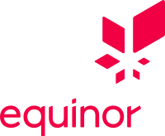
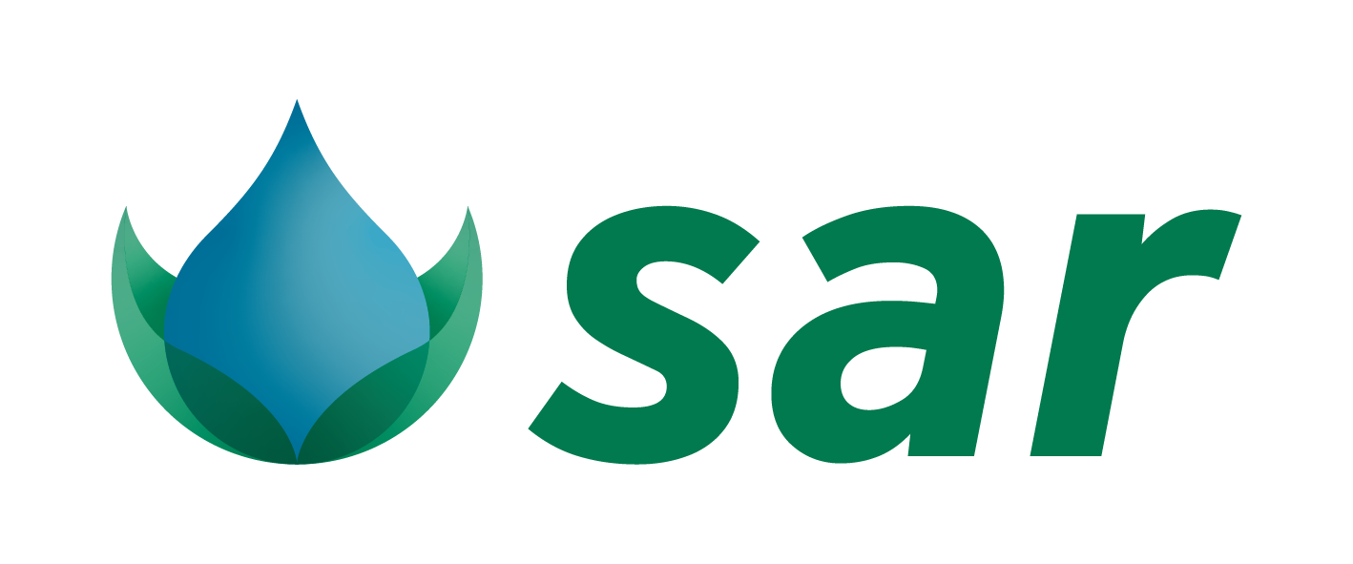








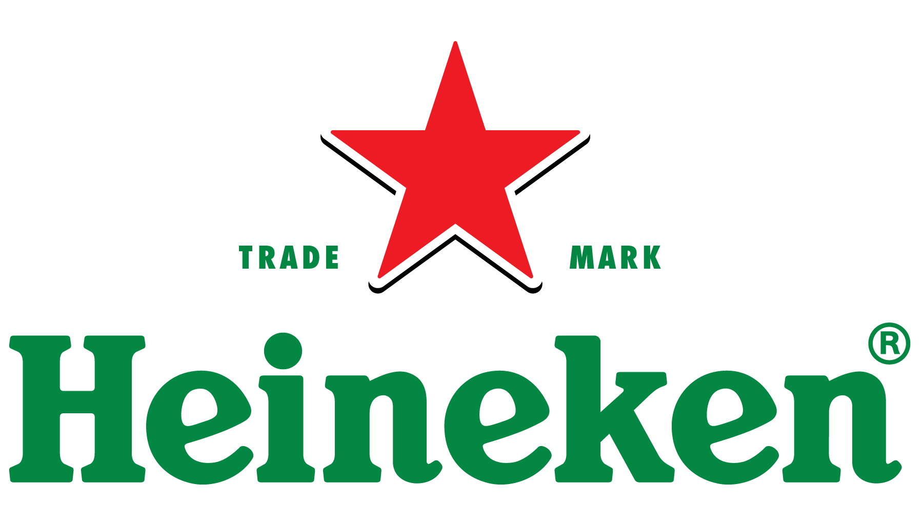

YDRO clients
The results of the Ydro Process® are validated by the scientific community in several studies,
and by a wide variety of customers worldwide
Ydro clients in different areas
Entities that carried out detailed studies on the Ydro Process®

Slide 7
The Ydro Process®
The Ydro Process® creates optimum conditions for growth, reproduction and microbial processes in the plant:
YDRO product content
Hydrolyzing Enzymes
Facultative cultures
Aerobic cultures
Micronutrients
Bio-enhancers
Powder or tablets
Features
Are naturally occurring bacteria.
Contain no animal derivatives.
Are not genetically manipulated.
Include additional strains uniquely tailored to treated waste type.
Application
Add water to start maturation. 1:10
Require a maturation time of approx 16 hours
During maturation population duplicates every 20 minutes.
Require no further chemical analysis when applied
Added daily.
Using the Ydro Process® is giving the following result:
Approx. 60-100% degradation and elimination of excess sludge
Significant improvement in plant effluent parameters (BOD, COD, SS, TN, TP etc)
Liquefaction and elimination of FOG (fats, oils and grease) in plant and pumping stations
Substantial odour elimination by Sulphur-utilizing bacteria.
Potential reduction in energy consumption at aeration stage
Potential increase in biogas production with simultaneous increase of methane content.
Significant reduction of micropollutants
Higher resistance to incoming organic shocks

Slide 8
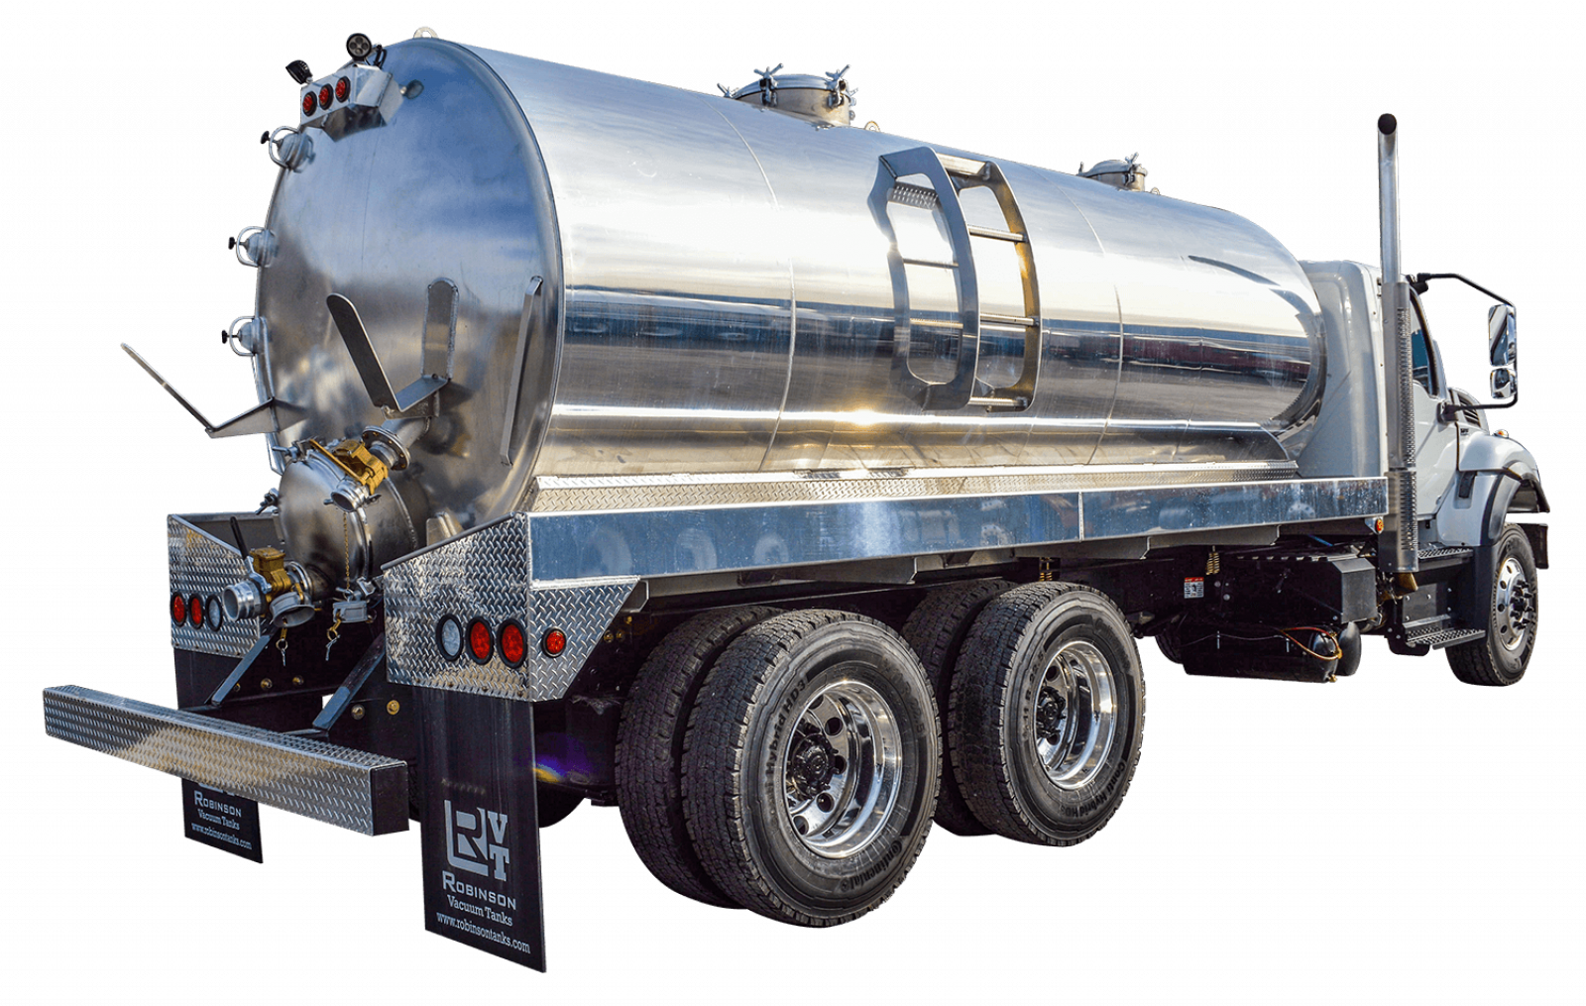
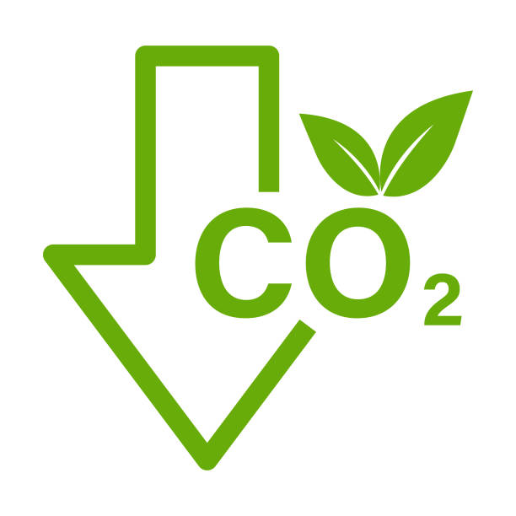
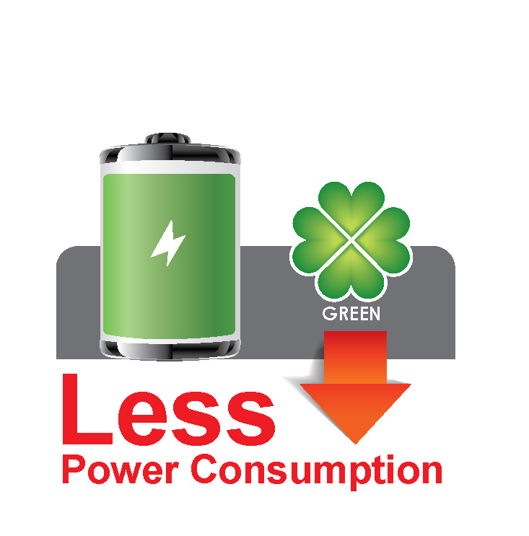


The Ydro Process®
The Ydro Process® microbial populations continually adapt to changeable conditions to ensure targets are consistently met.
Added bacteria become dominant
and existing bacteria adapt and is assimilated.
The added microorganisms produce enzymes which enhance the biological process.
Economical Benefits
Reduced cost for sludge handling and disposal
Redused energy cost
Reduced maintainance cost
Environmental benefits
Reduced CO2 emissions
Reduced energy need
Better Effluent values
Degradation of complex organic molecules, oils and greases into simple ones leading to production of Volatile Fatty Acids (VFAs), i.e. Acetic, Butyric, Propionic Acid etc.
VFAs converts to Carbon Dioxide (CO₂) and water (H₂O) in aerobic conditions and methane (CH₄) and hydrogen (H₂) in anaerobic conditions – and also into free, available energy.
Molecular breakdown and destruction in 80% of total biomass via a metabolic pathway, Catabolism. Only 20% of total biomass is utilised for new bacteria synthesis.
The Ydro Process® requires less oxygen: Ammonia (NH₄+) is converted to Nitrites (NO₂-) then Nitrogen (N₂), without first being converted to Nitrates (NO₃-) – where highest Oxygen usage occurs (depending on conditions).

Slide 9
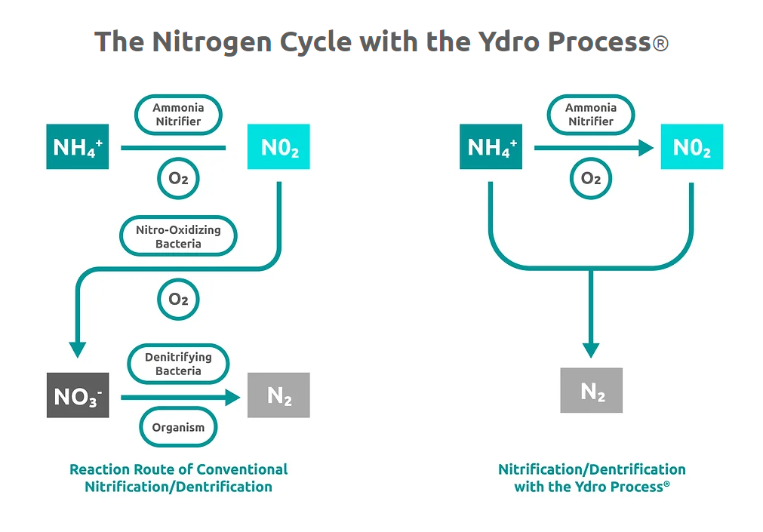
Nitrogen Cycle
Visualization

Slide 10
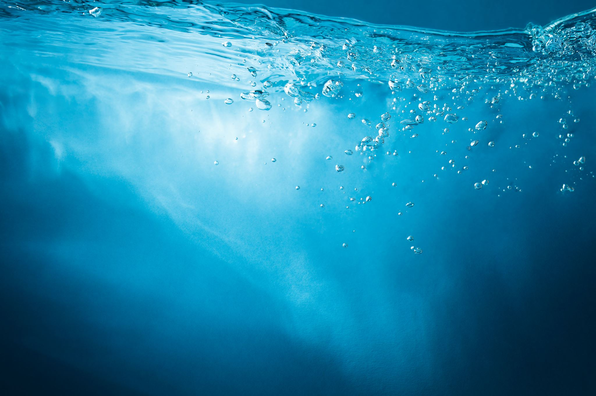
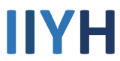


Visualization of the Ydro process
Back
Waste Water enters treatment plant
Ydro with added nutiants breaks complex molecules down to simple ones
Added microorganisms produce enzymes which enhance the biological proces
The degradation into simple molecules is leading to production of Volatile Fatty Acids
Molecular breakdown and destruction in 80% of total biomass via a metabolic pathway, Catabolism.
Ammonia (NH4+) is converted to Nitrites (NO2-) then Nitrogen (N2), without first being converted to Nitrates (NO3-)
Volatile Fatty Acids
VFA’s
i.e. Acetic, Butyric, Propionic Acid
H2O
Water
CO2
Carbon Dioxide
Solids
Aerobic conditions
CH4
Methane
H2
Hydrogen
Grease, fat, oil
Anaerobic conditions
Only 20% of total biomass is utilised for new bacteria synthesis.

Slide 11
Thank you!

